Slide 1
Discrete probability distributions
Mean, variance and standard deviation for a probability distribution.
Binomial distribution

Slide 2
Introduction. Events, sample space and probability
Events and sample space.
Definition. An event is a collection of outcomes for an experiment or a procedure.
Definition. A simple event is an event that cannot be broken down to simpler components.
Example. A simple event would be rolling a 6 when using 1 die. An event would be rolling a 7 when you roll 2 dice.

Slide 3
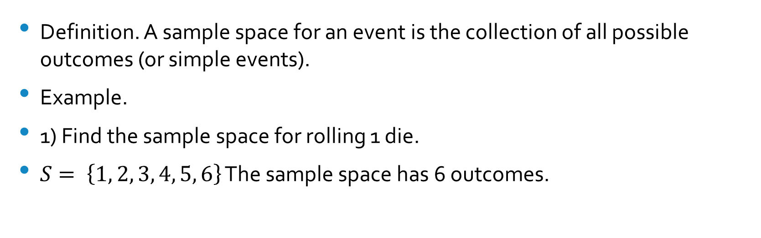
Definition. A sample space for an event is the collection of all possible outcomes (or simple events).
Example.
1) Find the sample space for rolling 1 die.
$S= \left\{1, 2, 3, 4, 5, 6\right\}$ The sample space has 6 outcomes.

Slide 4

Find the sample space for rolling 2 dice.
$\left\{\begin{aligned}1−1, 1−2, 1−3, 1−4, 1−5, 1−6, \\ 2−1, 2−2, 2−3, 2−4, 2−5, 2−6, \\ … \\ … \\ … \\ 6−1, 6−2, 6−3, 6−4, 6−5, 6−6\end{aligned}\right\}$
The sample space has 36 outcomes.

Slide 5

Probability values.
a) The probability of an impossible event is 0.
b) The probability of an event that is certain to occur is 1.
c) The probability of any other event is between 0 and 1: $0≤P(A)≤1$.

Slide 6
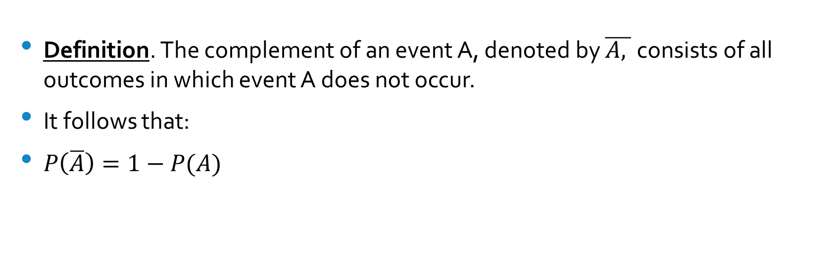
Complementary events
Definition. The complement of an event A, denoted by $\overline{A, }$consists of all outcomes in which event A does not occur.
It follows that:
$P\left(\overline{A}\right)=1−P(A)$

Slide 7
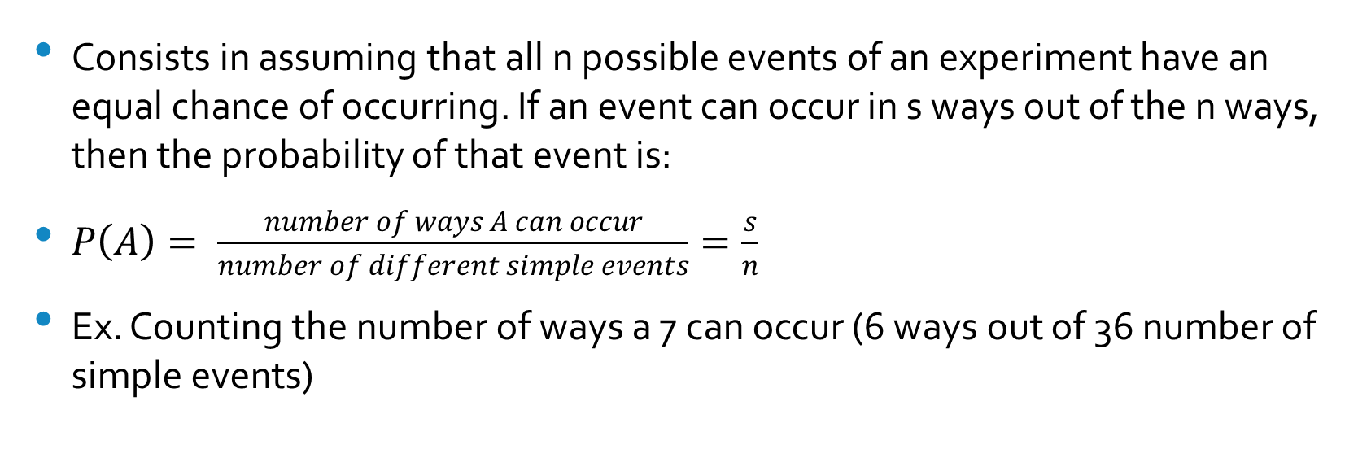
Classical approach to probability
Consists in assuming that all n possible events of an experiment have an equal chance of occurring. If an event can occur in s ways out of the n ways, then the probability of that event is:
$P\left(A\right)= \frac{number of ways A can occur}{number of different simple events}=\frac{s}{n}$
Ex. Counting the number of ways a 7 can occur (6 ways out of 36 number of simple events)

Slide 8
Random variable and discrete probability distributions
Definition. A random variable (x) is a variable that has a single numerical value for each outcome of an experiment.
Definition. A discrete random variable has a finite number of values or a countable number of values; a continuous random variable has infinitely many values, and can be associated with measurement on a continuous scale, when there are no gaps or interruptions.
Definition. The specification of the probabilities associated with the various distinct values of a discrete random variable is called a discrete probability distribution. The probability associated with the value x is denoted by the symbol P(x).

Slide 9
The probability distribution of a discrete random variable is a graph, table or formula that specifies the probability associated with each possible outcome the random variable can assume.
p(x) ≥ 0 for all values of x
Σp(x) = 1

Slide 10
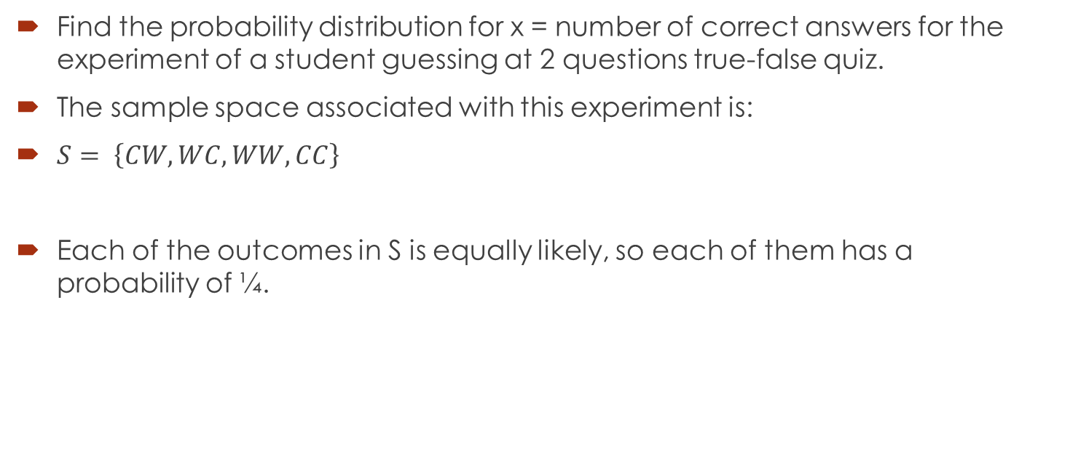
Example
Find the probability distribution for x = number of correct answers for the experiment of a student guessing at 2 questions true-false quiz.
The sample space associated with this experiment is:
$S= \left\{CW, WC, WW, CC\right\}$
Each of the outcomes in S is equally likely, so each of them has a probability of ¼.

Slide 11
The results can be organized in a table:
Outcome | x
CW | 1
WC | 1
WW | 0
CC | 2

Slide 12
We can calculate now the probability of each value of x:
For x = 0, the outcome is WW, so:
P(0) = P(WW) = ¼
For x = 1, the outcomes are CW and WC, so:
P(1) = 2/4 = ½
For x = 2, the outcome is CC, so:
P(2) = ¼

Slide 13
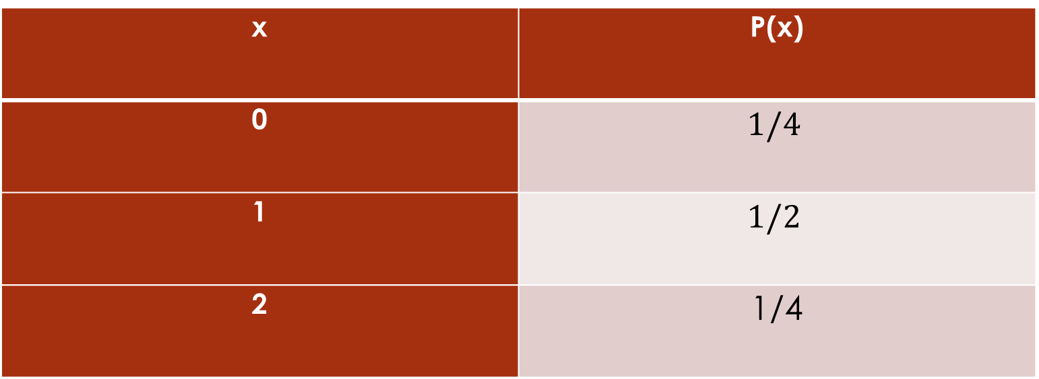
The values for the probability of the x variable can be organized in the following table:
x | P(x)
0 | $$1/4$$
1 | $$1/2$$
2 | 1/4

Slide 14
Graphical representation of discrete probability distribution
P(x)
0 1 2 x
1/2
1/4

Slide 15
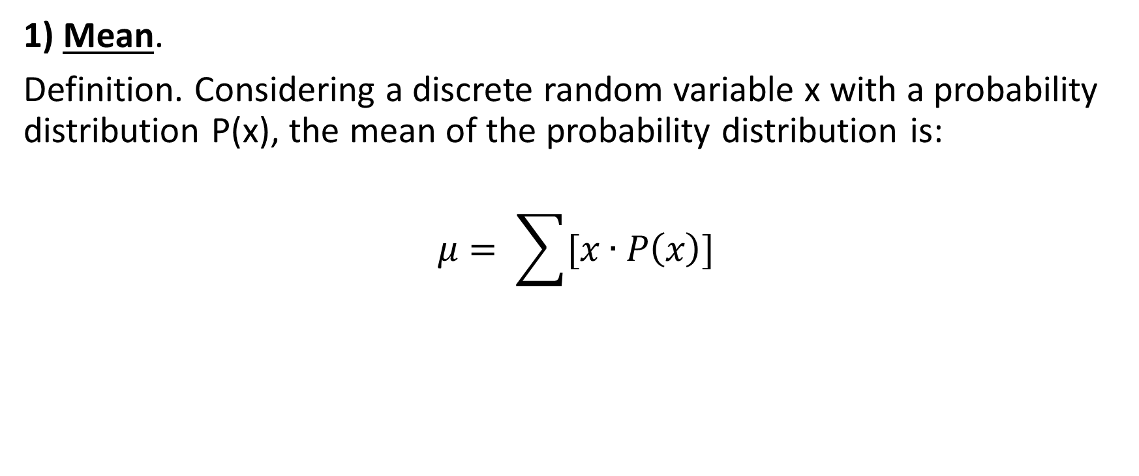
Mean, variance and standard deviation for a discrete probability distribution
1) Mean.
Definition. Considering a discrete random variable x with a probability distribution P(x), the mean of the probability distribution is:
$$μ= \sum{[x∙P\left(x\right)]}$$

Slide 16
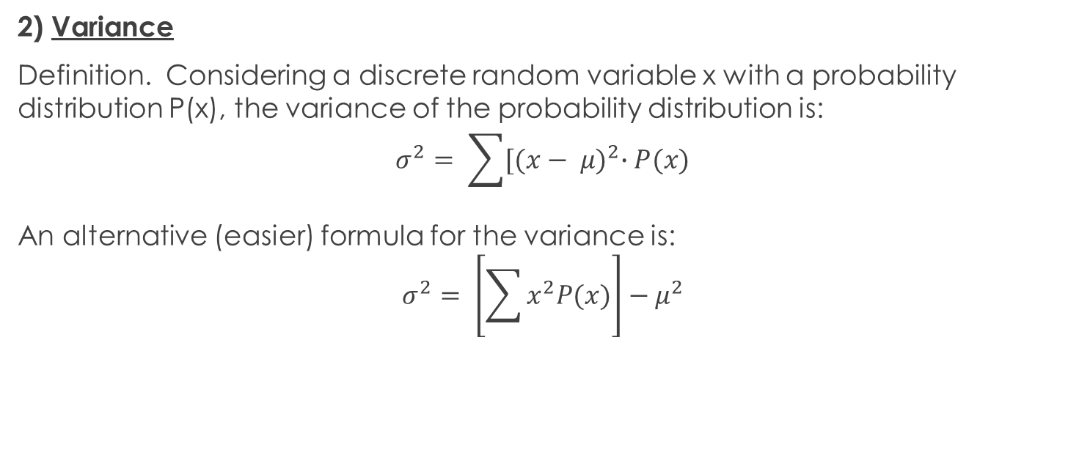
2) Variance
Definition. Considering a discrete random variable x with a probability distribution P(x), the variance of the probability distribution is: $$σ^{2}= \sum{{[(x− μ)}^{2}∙P(x)}$$
An alternative (easier) formula for the variance is: $$σ^{2}= \left[\sum{x^{2}P(x)}\right]−μ^{2}$$

Slide 17
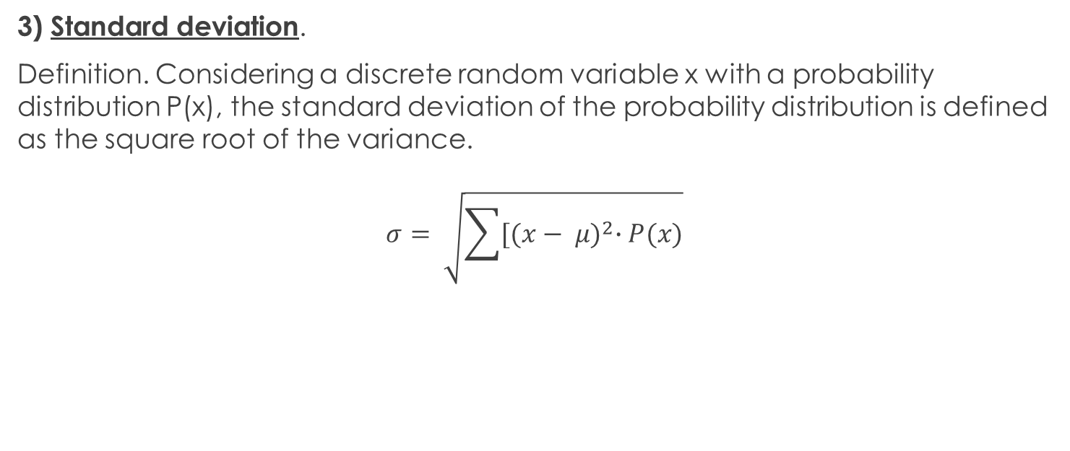
3) Standard deviation.
Definition. Considering a discrete random variable x with a probability distribution P(x), the standard deviation of the probability distribution is defined as the square root of the variance.
$$σ= \sqrt{\sum{{[(x− μ)}^{2}∙P(x)}}$$

Slide 18
Example
Consider the experiment of selecting a family with one child. If the random variable is the number of girls in that family, calculate the mean, variance and standard deviation for the probability distribution of this variable.

Slide 19
Step 1
The probabilities for the variable can be organized in the following table (assuming the event of a family having a girl or a boy is equally likely):
x | P(x)
0 | ½
1 | ½

Slide 20

Step 2. Calculate the mean, variance and standard deviation
1) Mean:
$μ= \sum{[x∙P\left(x\right)]}$ = 0 x P(0) +1 x P(1) = (0) (1/2) + (1) (1/2) = ½
2) Variance:
$$σ^{2}= \left[\sum{x^{2}P(x)}\right]−μ^{2}={\left(0\right)}^{2}∙P\left(0\right)+ {\left(1\right)}^{2}∙P\left(1\right)− {\left(\frac{1}{2}\right)}^{2}=\frac{1}{4}$$
3) Standard deviation:
$σ=1/2$

Slide 21
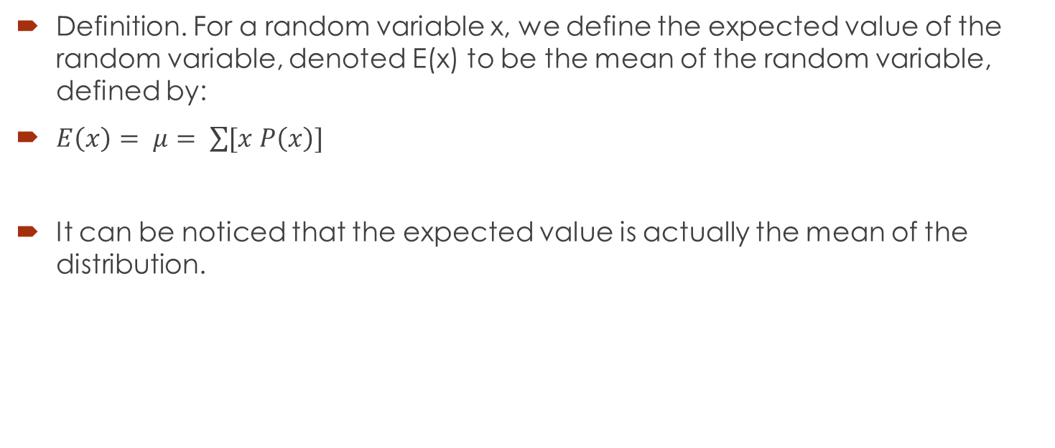
Expected value
Definition. For a random variable x, we define the expected value of the random variable, denoted E(x) to be the mean of the random variable, defined by:
$E\left(x\right)= μ= \sum{[x P\left(x\right)]}$
It can be noticed that the expected value is actually the mean of the distribution.

Slide 22
The binomial experiment
A binomial experiment is a statistical experiment that has the following properties:
- The experiment consists of n repeated trials;
- The trials are independent; that is, the outcome on one trial does not affect the outcome on other trials;
- Each trial can result in just two possible outcomes. We call one of these outcomes a success and the other, a failure;
- The probability of success, denoted by p, is the same on every trial.

Slide 23

Example: Consider the experiment of flipping a coin 2 times and counting the number of times the coin lands on heads. Is this a binomial experiment?

Slide 24
YES!
This is a binomial experiment because:
- The experiment consists of repeated trials. We flip a coin 2 times.
- The trials are independent; that is, getting heads on one trial does not affect whether we get heads on other trials.
- Each trial can result in just two possible outcomes - heads or tails.
- The probability of success is constant - 0.5 on every trial.

Slide 25
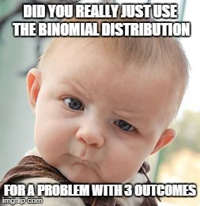
Do we use the binomial distribution here?

Slide 26
The Binomial Distribution
The Binomial Probability Distribution
The probability of getting the required number of successes
The number of ways of getting the desired results
The probability of getting the required number of failures
$$P\left(x\right)= {}_{n}^{}{C_{x}p^{x}{\left(1−p\right)}^{n−x}}={}_{n}^{}{C_{x}p^{x}q^{n−x}}$$

Slide 27
The Binomial Probability Distribution
p = P(s) on a single trial
q = 1 – p
n = number of trials
x = number of successes
$$P\left(x\right)= {}_{n}^{}{C_{x}p^{x}{\left(1−p\right)}^{n−x}}={}_{n}^{}{C_{x}p^{x}q^{n−x}}$$

Slide 28

Example
In the old days, there was a probability of 0.8 of success in any attempt to make a telephone call.
Calculate the probability of having 7 successes in 10 attempts.
$P\left(x=7\right)= {}_{n}^{}{C_{x}p^{x}q^{n−x}}$
= ${}_{10}^{}{C_{7}}×{0.8}^{7}×{0.2}^{3}=\text{0.20133}$

Slide 29

Mean, variance and standard deviation for the Binomial Distribution
A Binomial Random Variable has:
Mean: $μ=n p$
Variance: $σ^{2}=n p q$
Standard Deviation: $σ=\sqrt{n p q}$

Slide 30
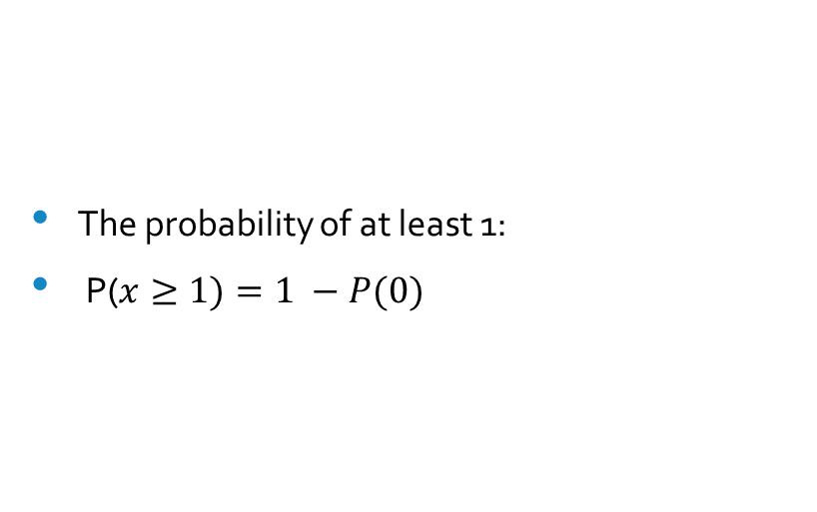
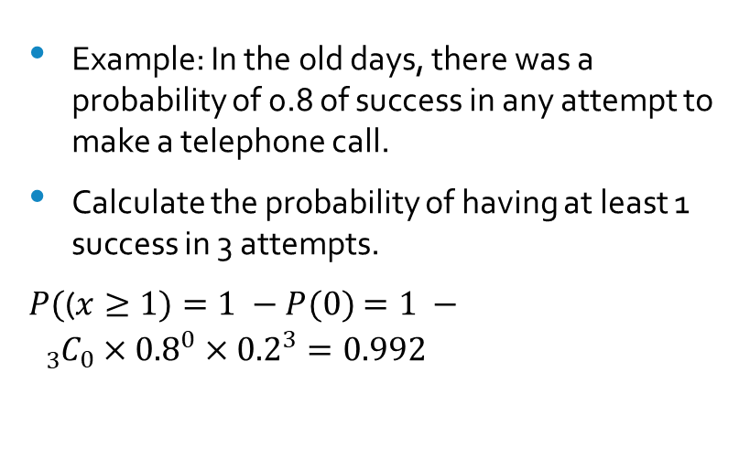
Probability of “at least 1”
The probability of at least 1:
P($x≥1)=1 −P(0)$
Example: In the old days, there was a probability of 0.8 of success in any attempt to make a telephone call.
Calculate the probability of having at least 1 success in 3 attempts.
$P($($x≥1)=1 −P(0)$ $=1 − {}_{3}^{}{C_{0}×{0.8}^{0}×{0.2}^{3}=0.992}$

Slide 32
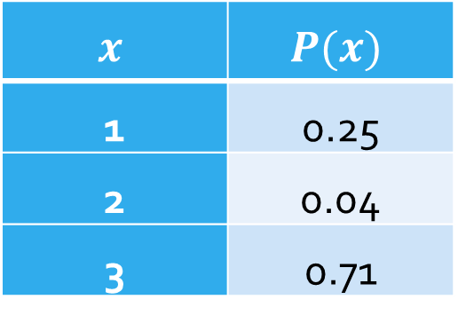
Practice 1. Determine the mean, the variance and the standard deviation of the following probability distribution:
$$x$$ | $$P(x)$$
1 | 0.25
2 | 0.04
3 | 0.71

Slide 34
2. A coin is tossed 2 times. Let x be the discrete random variable representing the number of times heads come up. Create a sample space for the experiment and calculate the expected value.

Slide 36
3. A factory is producing components packed in boxes of 10. 1% of the components is known to be defective. If a box is chosen at random: a) Find the probability that the box contains exactly 2 defective components. b) Find the probability that the box contains at least 2 defective components.

Slide 38
4.The manufacturer of a bag of sweets claims that there is a 90% chance that the bag contains some toffees. If 20 bags are chosen. What is the probability that a) All the bags contain toffees b) More than 18 bags contain toffees

Slide 40
5. In clinical trials a certain drug has an 8% success rate of curing a known disease. If 15 people are known to have the disease. What is the probability of at least 2 being cured?

Slide 42
6. Cross-fertilizing a red and a white flower produces red flowers 25% of the time. Now we cross-fertilize five pairs of red and white flowers and produce five offspring. a) Find the probability that there will be no red flowered plants in the five offspring. b) Find the probability that there would be one or fewer red flowered plants?

Slide 44
7. A roulette wheel has 38 slots, 18 are red, 18 are black, and 2 are green. You play five games and always bet on red. a) How many games can you expect to win? b) What is the probability that you will win all five games? c) If you win three or more games, you make a profit. If you win two or fewer games, you lose money. What is the probability that you will win no more than two games?

Slide 46
8. A company owns 400 laptops. Each laptop has an 8% probability of not working. You randomly select 20 laptops for your salespeople. a) What is the likelihood that 5 will be broken? b) What is the likelihood that at most 2 will be broken?

